Slide 1

STRATEGIC THINKING
CAPSTONE PROJECT
BÁRBARA ABREU COSTA - ID 2023099
JULIANA BRUM - ID 2023021
REPOSITORY: https://github.com/Babreucosta/CA2_Strategic_Thinking.git

Slide 2

Airbnb Prices in European Cities
Determinants of Price by Room Type, Location, Cleanliness Rating, and More

Slide 3


INTRODUCTION
Datasets from
An online platform that connects people who need accommodations with hosts who have space to rent
Notes:
The app allows users to search for and book unique accommodations in various locations around the world, such as apartments, houses, villas, and even castles. It also offers experiences and activities hosted by locals, giving travelers a chance to explore new places and cultures in an authentic way.

Slide 4
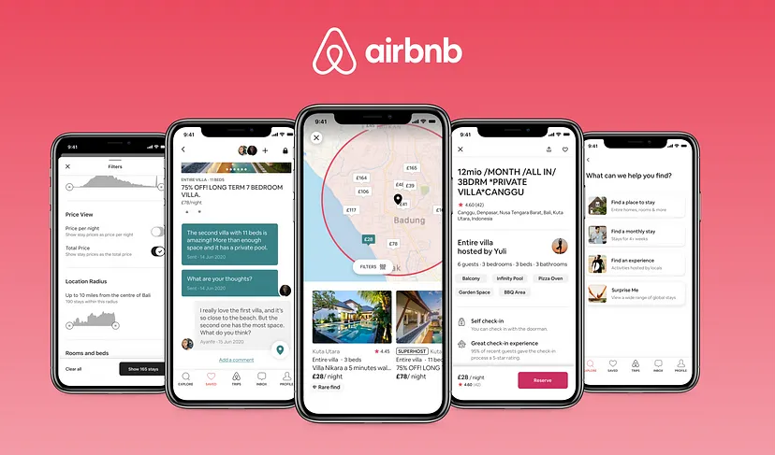
Notes:
The travel and lodging industries were revolutionised by Airbnb, a top online marketplace and hospitality platform, founded in 2008.
Connecting people who want to rent out their properties, typically their homes or apartments, with travellers seeking accommodations, Airbnb platform has had a transformative impact on the travel industry, disrupting traditional models and opening up new possibilities for both hosts and travellers. With its innovative platform and commitment to fostering connections and cultural exploration, Airbnb continues to shape the way people travel and experience the world.
The Superhost program is an exclusive recognition and reward system offered by Airbnb to its most exceptional hosts. Superhosts are recognized for consistently providing outstanding hospitality and creating memorable experiences for their guests.
As a Superhost on Airbnb, hosts have achieved a high level of excellence in providing exceptional hospitality and earning a reputation for being among the best hosts on the platform. Superhost status is a badge of honour that hosts can earn by consistently providing outstanding guest experiences and meeting certain criteria set by Airbnb.

Slide 5
BUSINESS DESCRIPTION
BUSINESS DESCRPTON
Hypothesis
General goal
Success
Hired by a group of investors
Help our clients about where to invest
Predict prices to apply in the properties
Notes:
We were hired by a group of investors that are looking for properties in Dublin to open some Airbnb accommodations and became a Superhost for Airbnb. We have an Airbnb dataset that has information about places in 10 different European cities on the weekdays and also on the weekends.
The data will help us to understand the best context about the place to open it in Dublin and what should this place offer to get good rates and become a superhost.

Slide 6
DATA UNDERSTANDING
LONDON city
Total 20 attributes
Divided weekdays ~ 4600 rows
and weekends ~ 5379 rows

Slide 7
DATA PREPARATION
No missing values
Dropped unimportant
Replace categorical columns ~ pd.get_dummies

Slide 8
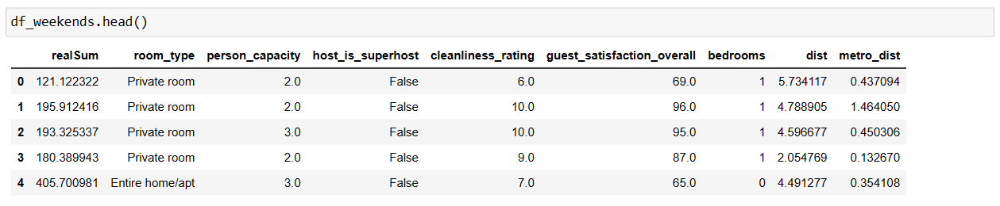
DATA PREPARATION
New df 09 attributes

Slide 9
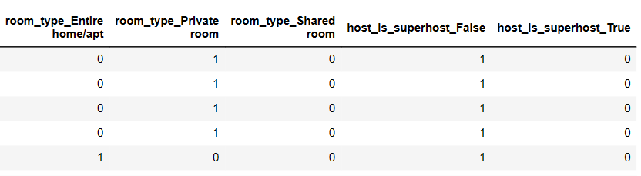
DATA PREPARATION
After pd.get_dummies 14 attributes used

Slide 10
DATA VISUALISATION

Slide 11
FEATURE SELECTION
AND F-TEST
Determined the significance of each feature in relation to the target variable
“F-Test is useful in feature selection as we get to know the significance of each feature in improving the model.”
(Asaithambi, 2018)

Slide 12
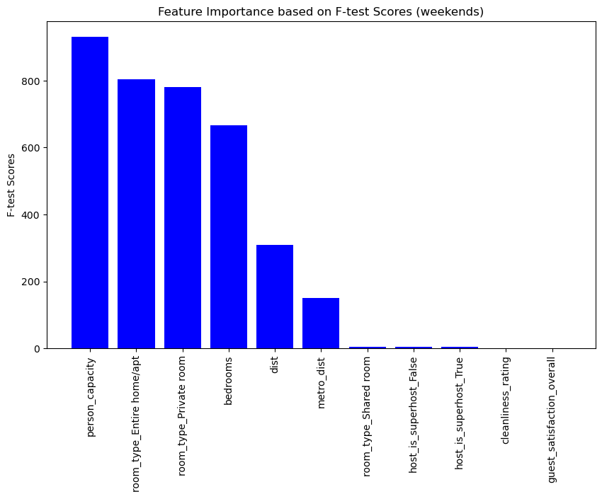
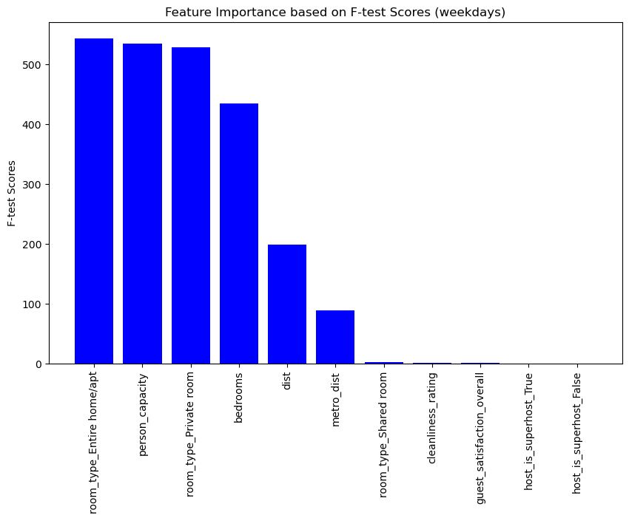
FEATURE SELECTION
AND F-TEST
WEEKENDS
WEEKDAYS

Slide 13
FEATURE SELECTION
AND F-TEST
Remove low F-test scores and p-values
'guest_satisfaction_overall'
'cleanliness_rating'
'host_is_superhost_True'
'host_is_superhost_False'
'room_type_Shared room'

Slide 14
MACHINE LEARNING
Linear regression
Random Forest Regressor
Gradient Boosting Regressor
XGBoost Regressor
Model Selection and Evaluation

Slide 15
MACHINE LEARNING
APPLIED FOR ALL MODELS
split the data twice
train 80% test 20%
train 70% test 30%

Slide 16
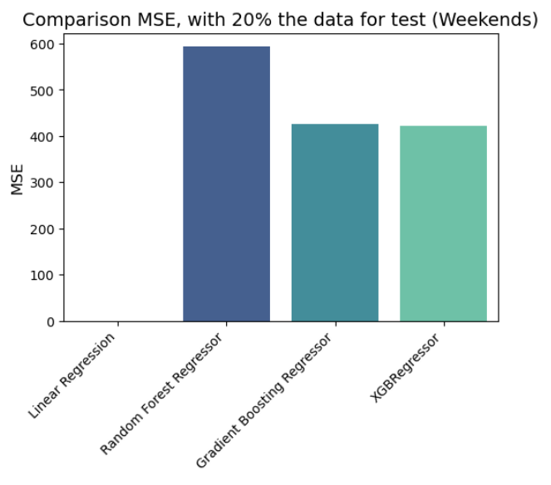
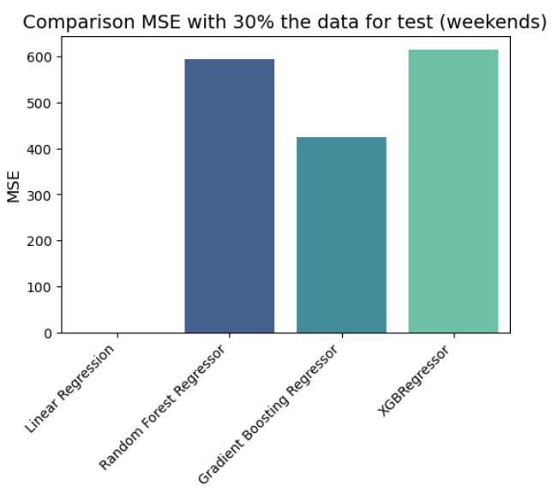
MACHINE LEARNING
WEEKENDS
MODELS COMPARISON

Slide 17
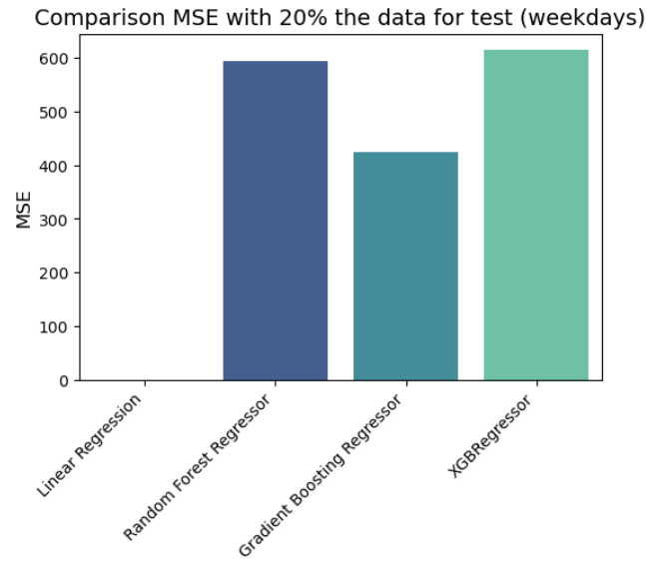
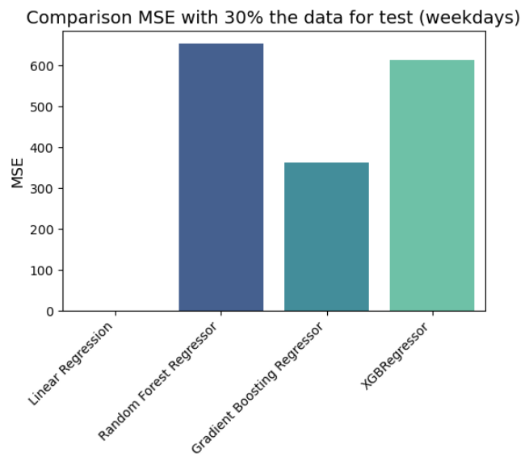
MACHINE LEARNING
WEEKDAYS
MODELS COMPARISON

Slide 18
MACHINE LEARNING

Slide 19
MACHINE LEARNING

Slide 20
RESULTS
max growth

Slide 21
CONCLUSION

Slide 22
THANK YOU !

Slide 23
CHALLENGES ENCOUNTERED
Challenge 1

Slide 24
CHALLENGES ENCOUNTERED
Challenge 2

Slide 25
CHALLENGES ENCOUNTERED
Challenge 3

